Slide 1
Big Data Analysis of Local Business and Reviews
Ruchi Singh, Yashaswi Ananth, Jongwook Woo
rsingh26@calstatela.edu , yananth@calstatela.edu , jwoo5@calstatela.edu
California State University, Los Angeles
Department of Computer and Information Systems
Notes:
‹#›
‹#›
‹#›
‹#›
‹#›
‹#›
‹#›
‹#›
1

Slide 2
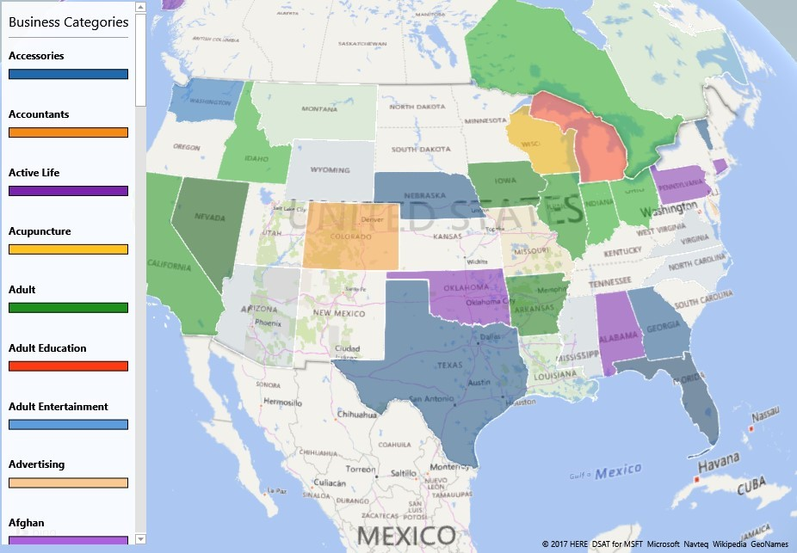
Introduction
Wide variety of information available about local business
Helps in understanding the performance of the Local Business
Derive insights from the customer reviews for the Local Business
Factors Responsible for the popularity of Local Business
Notes:
‹#›
‹#›
‹#›
‹#›
‹#›
‹#›
‹#›
‹#›
2

Slide 3
Definition: Big Data
Non-expensive frameworks that is distributed parallel systems and that can store a large scale data and process it in parallel [1, 2]
Hadoop
Non-expensive Super Computer
More public than the traditional super computers
Can store and process the applications
In university labs, small companies, research centers
Others
NoSQL DB (Cassandra, MongoDB, Redis, HBase,…)
ElasticSearch
Notes:
3
The term “Big Data” was first introduced to the computing world by Roger Magoulas from O’Reilly media in 2005 in order to define a great amount of data that traditional data management techniques cannot manage and process due to the complexity and size of this data.
There are a lot of definitions on Big Data circulating around the world, but we consider that the most important one is the one that each leader gives to its one company’s data. The way that Big Data is defined has implication in the strategy of a business. Each leader has to define the concept in order to bring competitive advantage for the company.

Slide 4
Two Cores in Big Data
How to store Big Data
GFS
Distributed Systems on non-expensive commodity computers
How to compute Big Data
MapReduce
Parallel Computing with non-expensive computers
Notes:
4
Every day, 2.5 quintillion bytes of data are created — so much that 90% of the data in the world today has been created in the last two years alone. This data comes from various sources such as: sensors used to gather climate information, posts to social media sites, digital pictures and videos, purchase transaction records, and cell phone GPS signals, web and software logs, cameras, information-sensing mobile devices, aerial sensory technologies and genomics. This data is referred to as big data
Global file System

Slide 5
Importance of Big Data
Use of Big Data in major areas
Security of IT and Trouble shooting
Customer Service
Improving Services and Products
Detection of online fraud
Risk Assessment
Notes:
In information technology in order to improve security and troubleshooting by analyzing the patterns in the existing logs;
• In customer service by using information from call centers in order to get the customer pattern and thus enhance customer satisfaction by customizing services;
• In improving services and products through the use of social media content. By knowing the potential customers preferences the company can modify its product in order to address a larger area of people;
• In the detection of fraud in the online transactions for any industry;
• In risk assessment by analyzing information from the transactions on the financial market.
In IBM’s view Big Data has four aspects:
Volume: refers to the quantity of data gathered by a company. This data must be used further to obtain important knowledge;
Velocity: refers to the time in which Big Data can be processed. Some activities are very important and need immediate responses, that is why fast processing maximizes efficiency;
Variety: Refers to the type of data that Big Data can comprise. This data can be structured as well as unstructured;
Veracity: refers to the degree in which a leader trusts the used information in order to take decision. So getting the right correlations in Big Data is very important for the business future.

Slide 6
Our Approach
Technical Details
Hadoop: Hive and Pig
Horizontally Scalable: Scale Out
The more the data size, the more nodes can be added to the cluster
Cloud Platform Details
That can be scaled out and analyze massive data set from the small data set
As well as
Insights
Visual Results
IBM Bluemix Specifications
Management Nodes: 1 | vCPU | 12
 | RAM | 48 GB
Data Nodes: 1 | vCPU | 4
 | RAM | 24 GB
 | Data Disk | 1 TB SATA
CPU Speed |  | 2.4 GHz Intel Xeon ES-2673
Notes:
6
HiveQL and Pig are the querying tools built on top of Hadoop that is used to query data within HDFS. Hive and Pig inherit all of Hadoop’s fault tolerance features and is scalable for Big Data. The Hive language resembles SQL, which makes it useful for creating reports by Data Analysts whereas Pig is a Procedural Data Flow language used for programming by researchers and programmers.
Visualizations are generated in Tableau and Excel power view that create multi-faceted views of data and help communicate complex ideas simply.

Slide 7
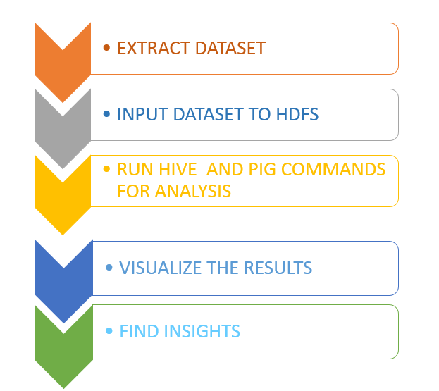
Technical Specification
DATA SOURCE | FILE SIZE
Yelp | 1.98GB
Google Local | 85MB
Technologies Used:
Hadoop Big Data
Hive and Pig
Tableau
Excel Power View
Notes:
‹#›
‹#›
‹#›
‹#›
‹#›
‹#›
‹#›
‹#›
2
We have worked on Hadoop ecosystem to perform the Big data analytics and have built the project on IBMs Biginsight.

Slide 8
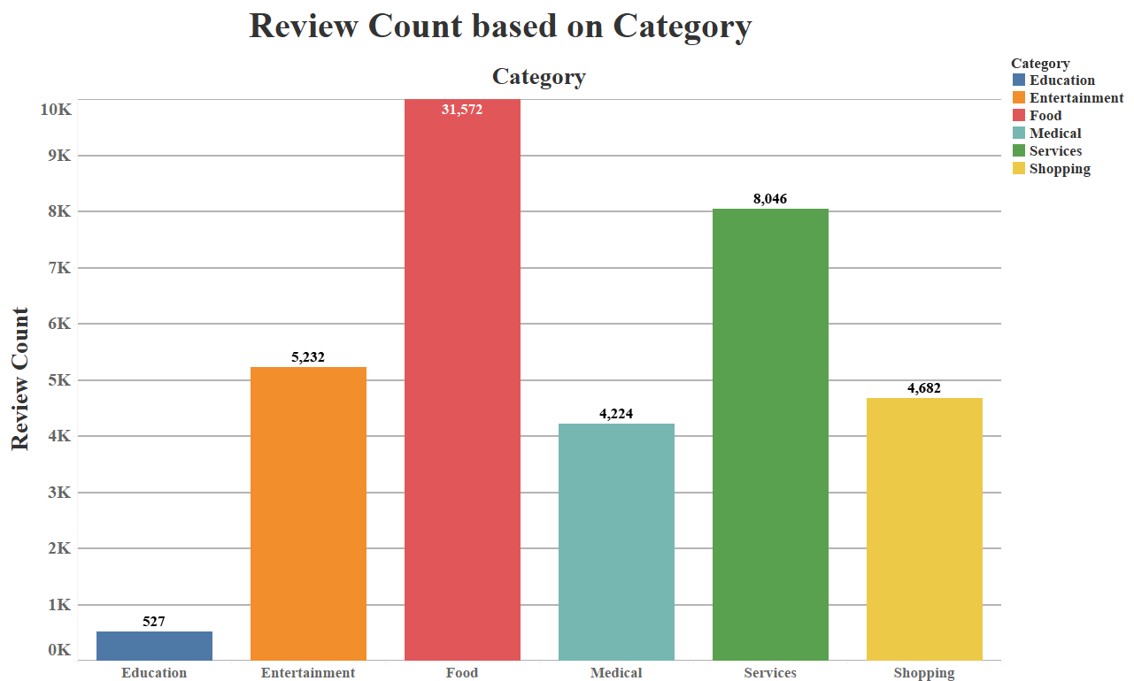
Education
Entertainment
Food
Medical
Services
Shopping
Notes:
‹#›
‹#›
‹#›
‹#›
‹#›
‹#›
‹#›
‹#›
2

Slide 9
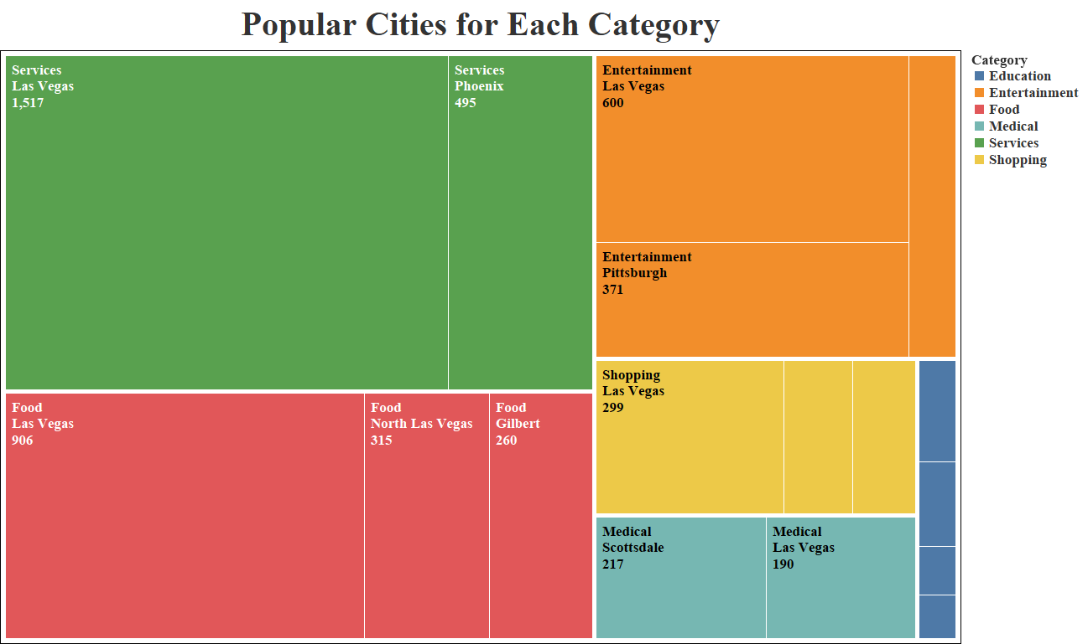
Location based review Count
Notes:
‹#›
‹#›
‹#›
‹#›
‹#›
‹#›
‹#›
‹#›
2

Slide 10
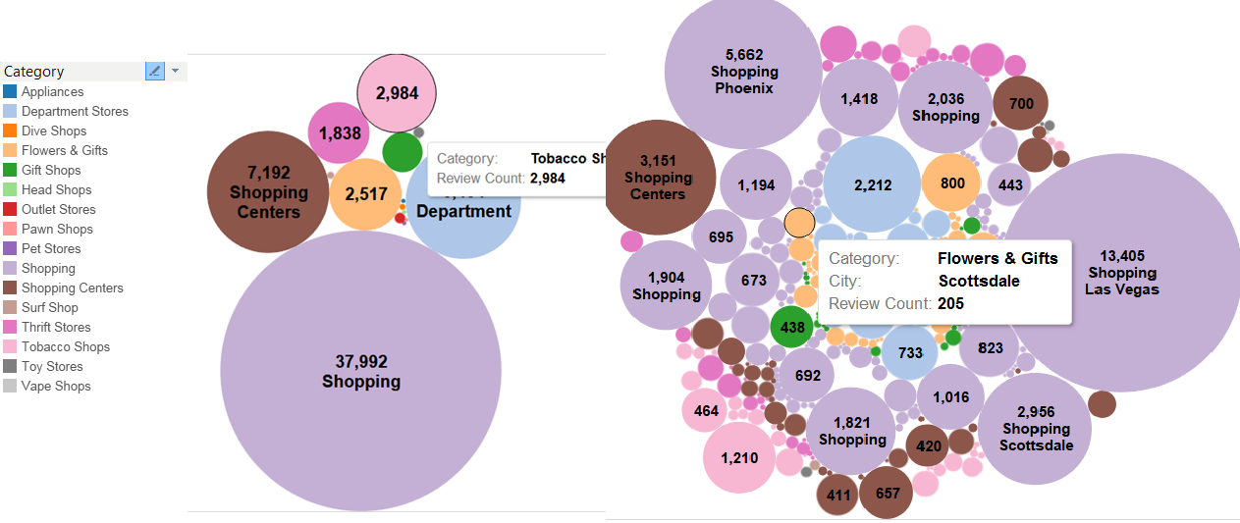
Sub Categories of Shopping
Notes:
‹#›
‹#›
‹#›
‹#›
‹#›
‹#›
‹#›
‹#›
2

Slide 11
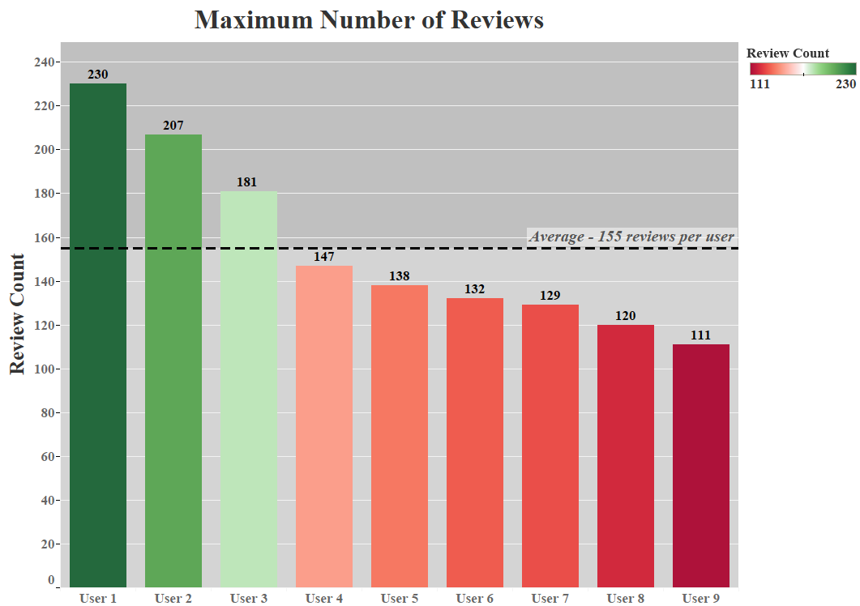
Review Count
Maximum number of reviews made by unique user IDs over 10 years
Further text analysis of the reviews confirmed all reviews for user to be genuine.
Notes:
‹#›
‹#›
‹#›
‹#›
‹#›
‹#›
‹#›
‹#›
2

Slide 12
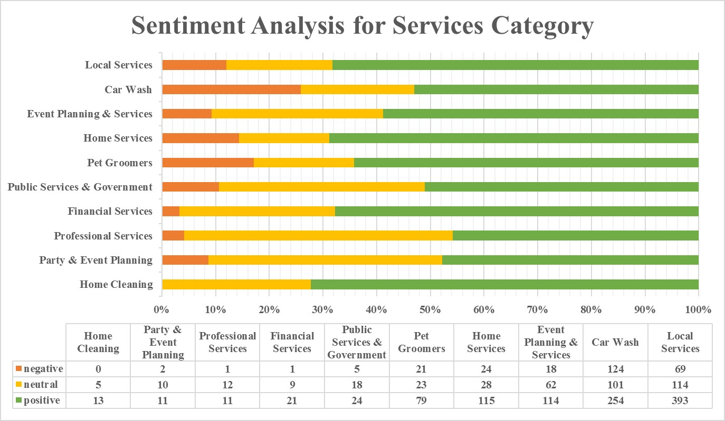
Sentiment Analysis of Service Category Business
Notes:
‹#›
‹#›
‹#›
‹#›
‹#›
‹#›
‹#›
‹#›
2

Slide 13
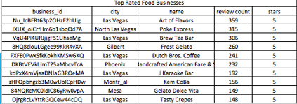
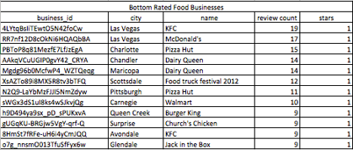
Food Business Attributes Analysis
Key Attributes
Reservation |  | Ambiance |  | Wheelchair |  | TV |  | Wi-fi
Top | Bottom | Top | Bottom | Top | Bottom | Top | Bottom | Top | Bottom
80% | 20% | 70% | 40% | 70% | 10% | 60% | 30% | 80% | 30%
Notes:
‹#›
‹#›
‹#›
‹#›
‹#›
‹#›
‹#›
‹#›
2

Slide 14
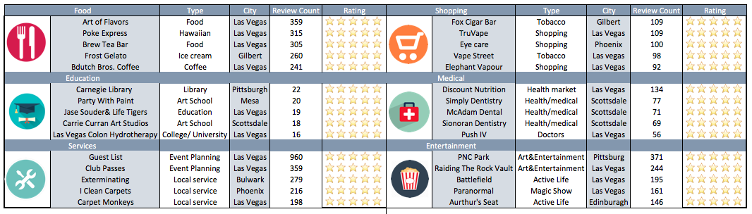
Top Business
Top 5 most popular local business on Yelp between 2006-2016 in the selected cities
Notes:
‹#›
‹#›
‹#›
‹#›
‹#›
‹#›
‹#›
‹#›
2

Slide 15
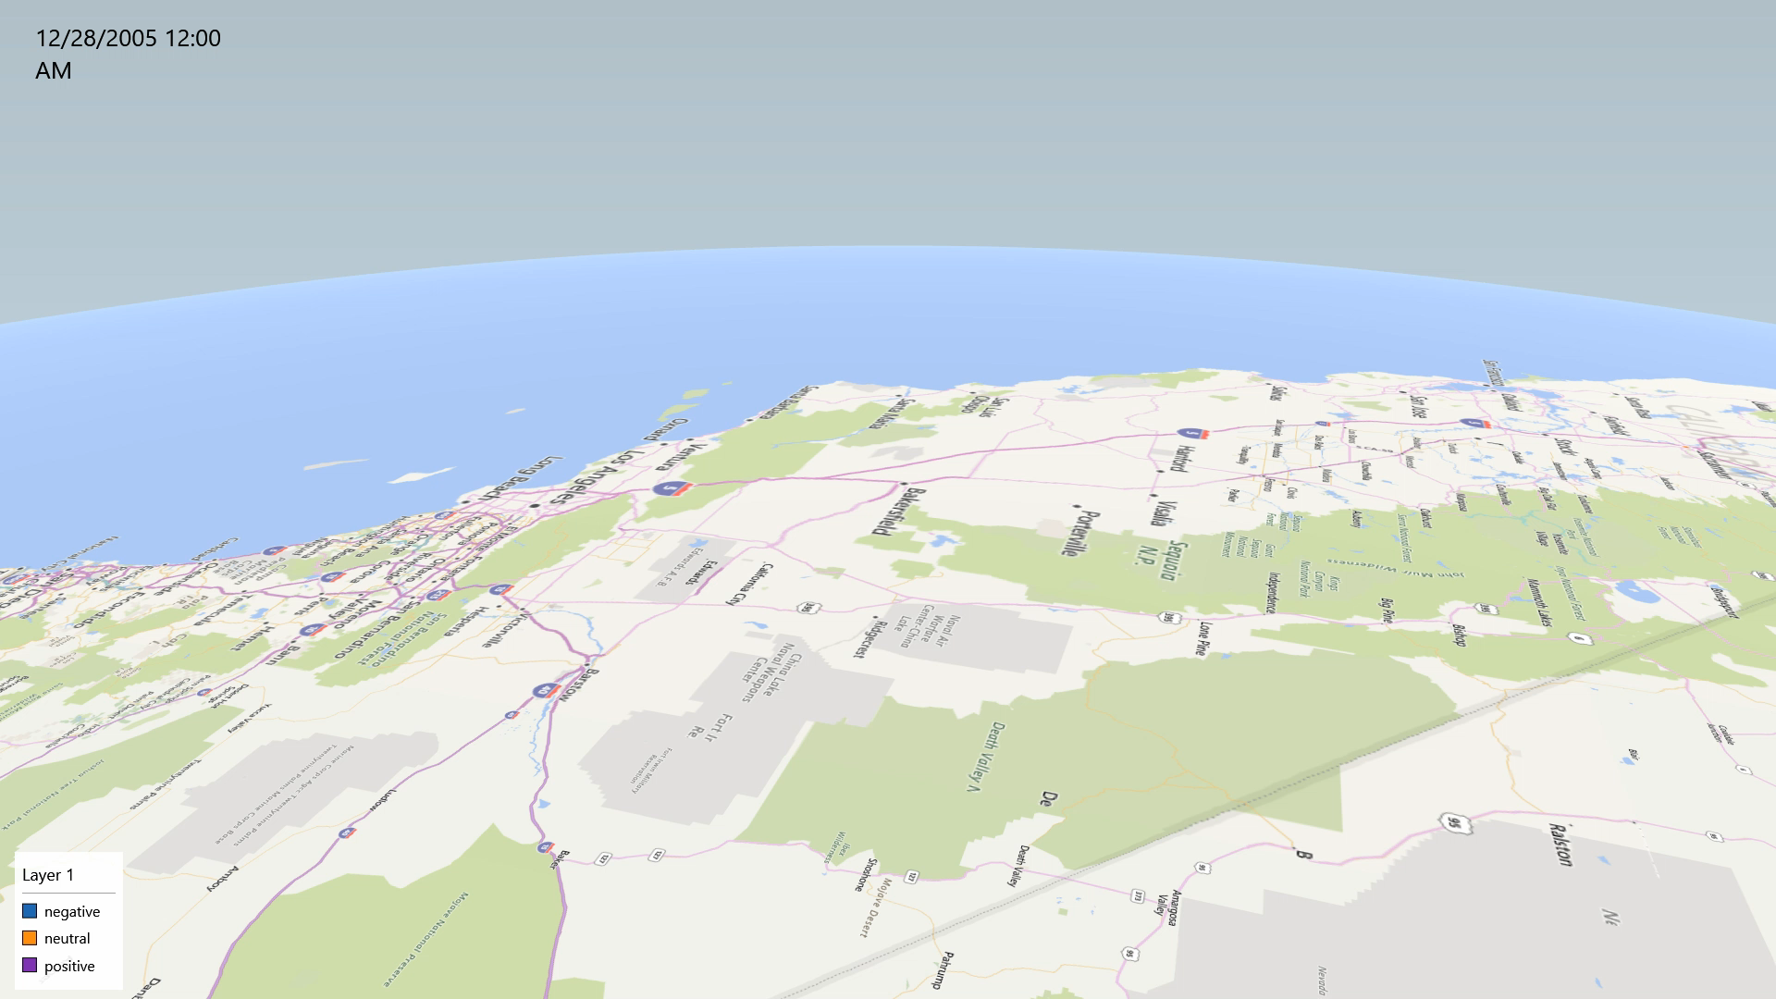
Introduction
Notes:
‹#›
‹#›
‹#›
‹#›
‹#›
‹#›
‹#›
‹#›
2

Slide 16
Conclusion
Food is the most popular category of Local Business based on the reviews
Las Vegas is the most popular city based on review count for Local Business in every category
Reservation, Ambience, Wi-Fi are some of the main factors responsible for the popularity of food business
More than 60% of people in a city write positive reviews for Local Business
Around 250 reviews(maximum) were written by one reviewer in a span of 10 years
Notes:
‹#›
‹#›
‹#›
‹#›
‹#›
‹#›
‹#›
‹#›
2

Slide 17
References
“Market Basket Analysis Algorithm with Map/Reduce of Cloud Computing”, Jongwook Woo and Yuhang Xu, The 2011 international Conference on Parallel and Distributed Processing Techniques and Applications (PDPTA 2011), Las Vegas (July 18-21, 2011)
Jongwook Woo, DMKD-00150, “Market Basket Analysis Algorithms with MapReduce”, Wiley Interdisciplinary Reviews Data Mining and Knowledge Discovery, Oct 28 2013, Volume 3, Issue 6, pp445-452, ISSN 1942-4795
Github, “https://github.com/rsingh26/DataScience/tree/master/BigData-Hadoop”
P. Zikipoulos, T. Deutsch, D. Deroos, Harness the Power of Big Data, 2012, http://www.ibmbigdatahub.com/blog/harnes s-power-big-data-book-excerpt
Notes:
‹#›
‹#›
‹#›
‹#›
‹#›
‹#›
‹#›
‹#›
2

Slide 18
Thank You
Questions…
Notes:
‹#›
‹#›
‹#›
‹#›
‹#›
‹#›
‹#›
‹#›
2

